Slide 2

Chapter Goals
To collect elements using arrays and array lists
To use the enhanced for loop for traversing arrays and array lists
To learn common algorithms for processing arrays and array lists
To work with two-dimensional arrays
To understand the concept of regression testing

Slide 3

Array Lists
An array list stores a sequence of values whose size can change.
An array list can grow and shrink as needed.
ArrayList class supplies methods for many common tasks, such as inserting and removing elements.
An array list expands to hold as many elements as needed.

Slide 4
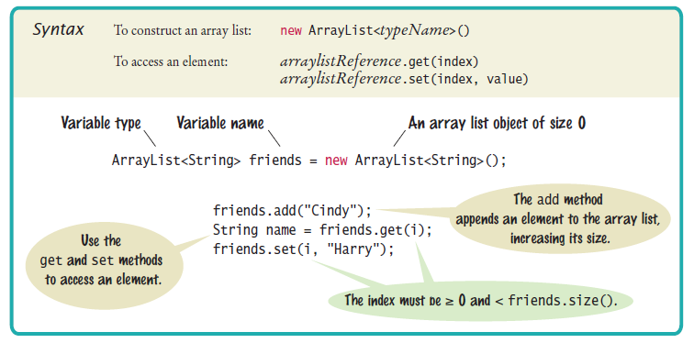
Syntax 7.4 Array Lists

Slide 5
Declaring and Using Array Lists
To declare an array list of strings
ArrayList<String> names = new ArrayList<String>();
To use an array list
import java.util.ArrayList;
ArrayList is a generic class
Angle brackets denote a type parameter
Replace String with any other class to get a different array list type

Slide 6
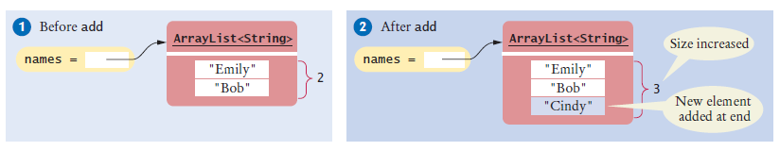
Declaring and Using Array Lists
ArrayList<String> is first constructed, it has size 0
Use the add method to add an object to the end of the array list:
names.add("Emily"); // Now names has size 1 and element "Emily”
names.add("Bob"); // Now names has size 2 and elements "Emily", "Bob”
names.add("Cindy"); // names has size 3 and elements "Emily", "Bob",
// and "Cindy”
The size method gives the current size of the array list.
Size is now 3
Figure 17 Adding an Array List Element with add

Slide 7
Declaring and Using Array Lists
To obtain an array list element, use the get method
Index starts at 0
To retrieve the name with index 2:
String name = names.get(2); // Gets the third element
// of the array list
The last valid index is names.size() - 1
A common bounds error:
int i = names.size();
name = names.get(i); // Error
To set an array list element to a new value, use the set method:
names.set(2, "Carolyn");

Slide 8

Declaring and Using Array Lists
An array list has methods for adding and removing elements in the middle.
This statement adds a new element at position 1 and moves all elements with index 1 or larger by one position.
names.add(1, "Ann");

Slide 9
Declaring and Using Array Lists
The remove method,
removes the element at a given position
moves all elements after the removed element down by one position
and reduces the size of the array list by 1.
names.remove(1);
To print an array list:
System.out.println(names);
// Prints [Emily, Bob, Carolyn]

Slide 10
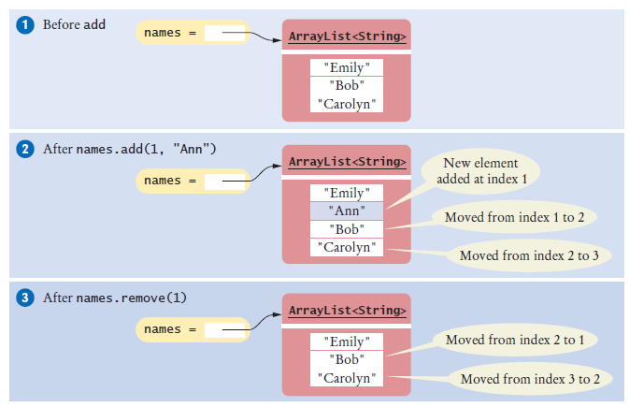
Declaring and Using Array Lists
Figure 18 Adding and Removing Elements in the Middle of an Array List

Slide 11
Using the Enhanced for Loop with Array Lists
You can use the enhanced for loop to visit all the elements of an array list
ArrayList<String> names = . . . ;
for (String name : names)
{
System.out.println(name);
}
This is equivalent to:
for (int i = 0; i < names.size(); i++)
{
String name = names.get(i);
System.out.println(name);
}

Slide 12
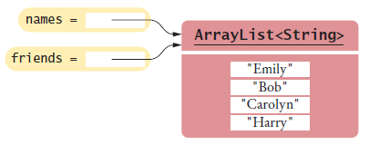
Copying Array Lists
Copying an array list reference yields two references to the same array list.
After the code below is executed
Both names and friends reference the same array list to which the string "Harry" was added.
ArrayList<String> friends = names;
friends.add("Harry");
Figure 19 Copying an Array List Reference

Slide 13
Copying Array Lists
To make a copy of an array list, construct the copy and pass the original list into the constructor:
ArrayList<String> newNames =
new ArrayList<String>(names);

Slide 14
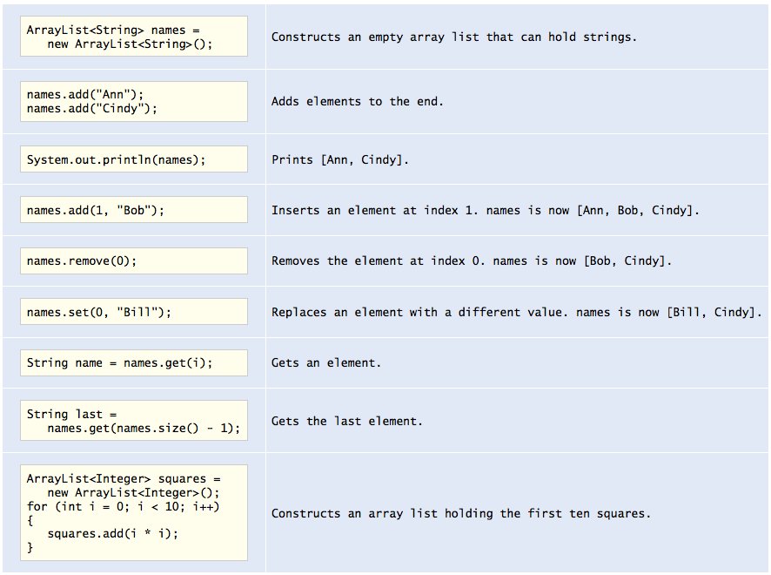
Working With Array Lists

Slide 15

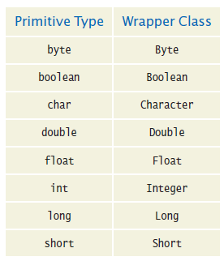
Wrapper Classes
You cannot directly insert primitive type values into array lists.
Like truffles that must be in a wrapper to be sold, a number must be placed in a wrapper to be stored in an array list.
Use the matching wrapper class.

Slide 16
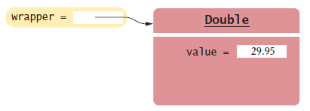
Wrapper Classes
To collect double values in an array list, you use an ArrayList<Double>.
If you assign a double value to a Double variable, the number is automatically “put into a box”
Called auto-boxing:
Automatic conversion between primitive types and the corresponding wrapper classes:
Double wrapper = 29.95;
Wrapper values are automatically “unboxed” to primitive types
double x = wrapper;
Figure 20 A Wrapper Class Variable

Slide 17
Using Array Algorithms with Array Lists
The array algorithms can be converted to array lists simply by using the array list methods instead of the array syntax.
Code to find the largest element in an array:
double largest = values[0];
for (int i = 1; i < values.length; i++)
{
if (values[i] > largest) { largest = values[i]; }
}
Code to find the largest element in an array list:
double largest = values.get(0);
for (int i = 1; i < values.size(); i++)
{
if (values.get(i) > largest) { largest = values.get(i); }
}

Slide 18
Storing Input Values in an Array List
To collect an unknown number of inputs, array lists are much easier to use than arrays.
Simply read the inputs and add them to an array list:
ArrayList<Double> inputs = new ArrayList<Double>();
while (in.hasNextDouble())
{
inputs.add(in.nextDouble());
}

Slide 19
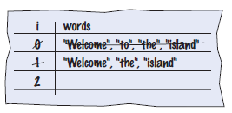
Removing Matches
To remove elements from an array list, call the remove method.
Error: skips the element after the moved element
ArrayList<String> words = ...;
for (int i = 0; i < words.size(); i++)
{
String word = words.get(i);
if (word.length() < 4)
{
Remove the element at index i.
}
}
Concrete example

Slide 20
Removing Matches
Should not increment i when an element is removed
Pseudocode
If the element at index i matches the condition
Remove the element.
Else
Increment i.

Slide 21
Removing Matches
Use a while loop, not a for loop
int i = 0;
while (i < words.size())
{
String word = words.get(i);
if (word.length() < 4) { words.remove(i); }
else { i++; }
}

Slide 22
Choosing Between Array Lists and Arrays
For most programming tasks, array lists are easier to use than arrays
Array lists can grow and shrink.
Arrays have a nicer syntax.
Recommendations
If the size of a collection never changes, use an array.
If you collect a long sequence of primitive type values and you are concerned about efficiency, use an array.
Otherwise, use an array list.

Slide 23
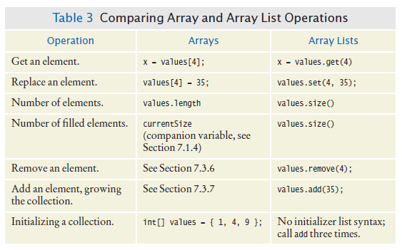
Choosing Between Array Lists and Arrays

Slide 24
section_7/LargestInArrayList.java
1 import java.util.ArrayList;
2 import java.util.Scanner;
3
4 /**
5 This program reads a sequence of values and prints them, marking the largest value.
6 */
7 public class LargestInArrayList
8 {
9 public static void main(String[] args)
10 {
11 ArrayList<Double> values = new ArrayList<Double>();
12
13 // Read inputs
14
15 System.out.println("Please enter values, Q to quit:");
16 Scanner in = new Scanner(System.in);
17 while (in.hasNextDouble())
18 {
19 values.add(in.nextDouble());
20 }
21
Continued

Slide 25
section_7/LargestInArrayList.java
22 // Find the largest value
23
24 double largest = values.get(0);
25 for (int i = 1; i < values.size(); i++)
26 {
27 if (values.get(i) > largest)
28 {
29 largest = values.get(i);
30 }
31 }
32
33 // Print all values, marking the largest
34
35 for (double element : values)
36 {
37 System.out.print(element);
38 if (element == largest)
39 {
40 System.out.print(" <== largest value");
41 }
42 System.out.println();
43 }
44 }
45 }
Continued

Slide 26
section_7/LargestInArrayList.java
Program Run
Please enter values, Q to quit:
35 80 115 44.5 Q
35
80
115 <== largest value
44.5

